Slide 1
Come Fly With Me
An insight into aviation traffic within Australia

Slide 2
Why is aviation important?
Aviation is a growing necessity in keeping our modern world connected
Australia is especially reliant on aviation due to a lack of land borders

Slide 3
Aims
Investigate seasonal patterns in activity
Find growing hotspots in Australia

Slide 4
Data Source

Slide 5

Aviation statistics are published by the Bureau of Infrastructure, Transport, and Regional Economics (BITRE)
International & domestic activity are both available

Slide 6
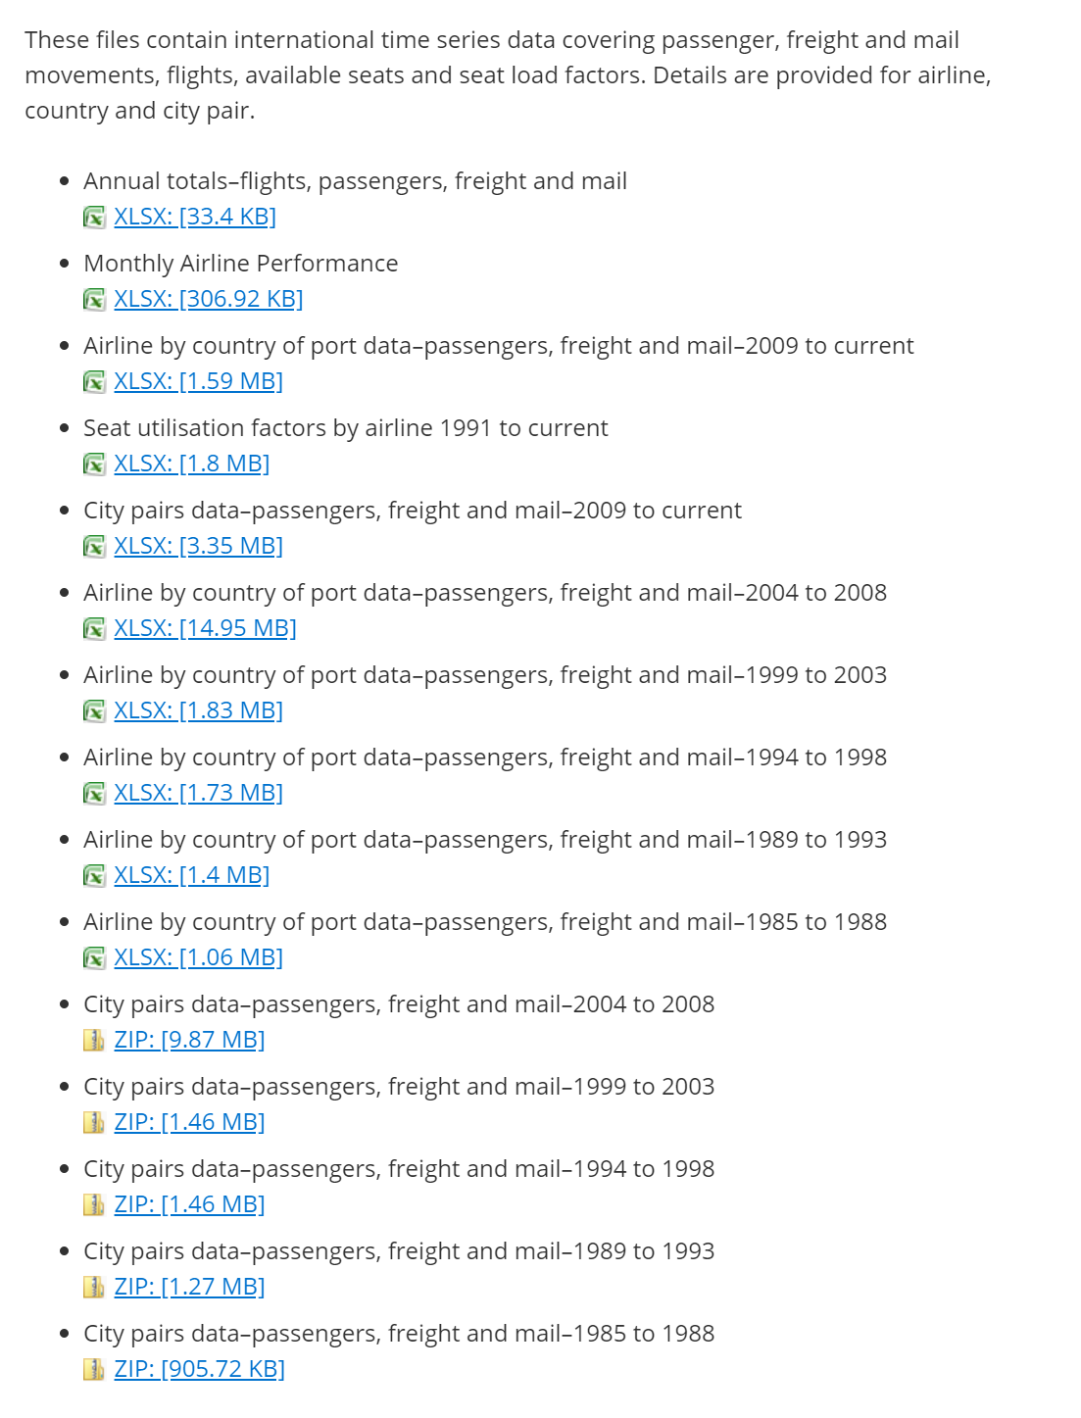
International
City pairs datasets are the most interesting

Slide 7
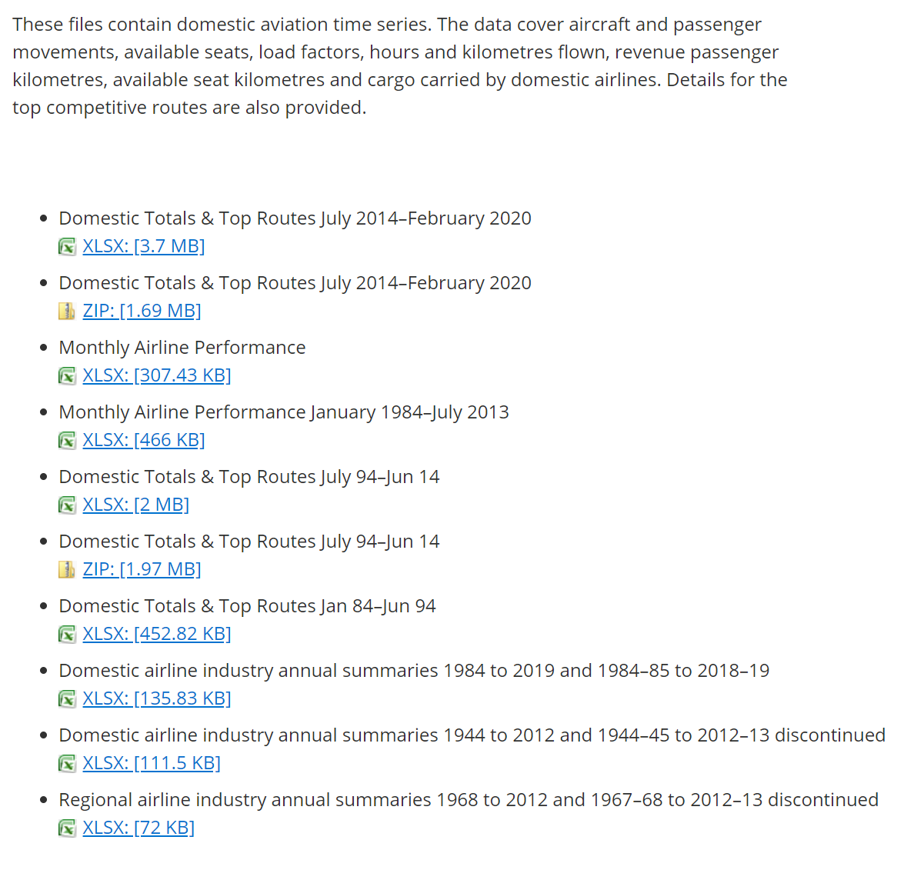
Domestic
Domestic Top Routes is similar to the International City Pairs data

Slide 8
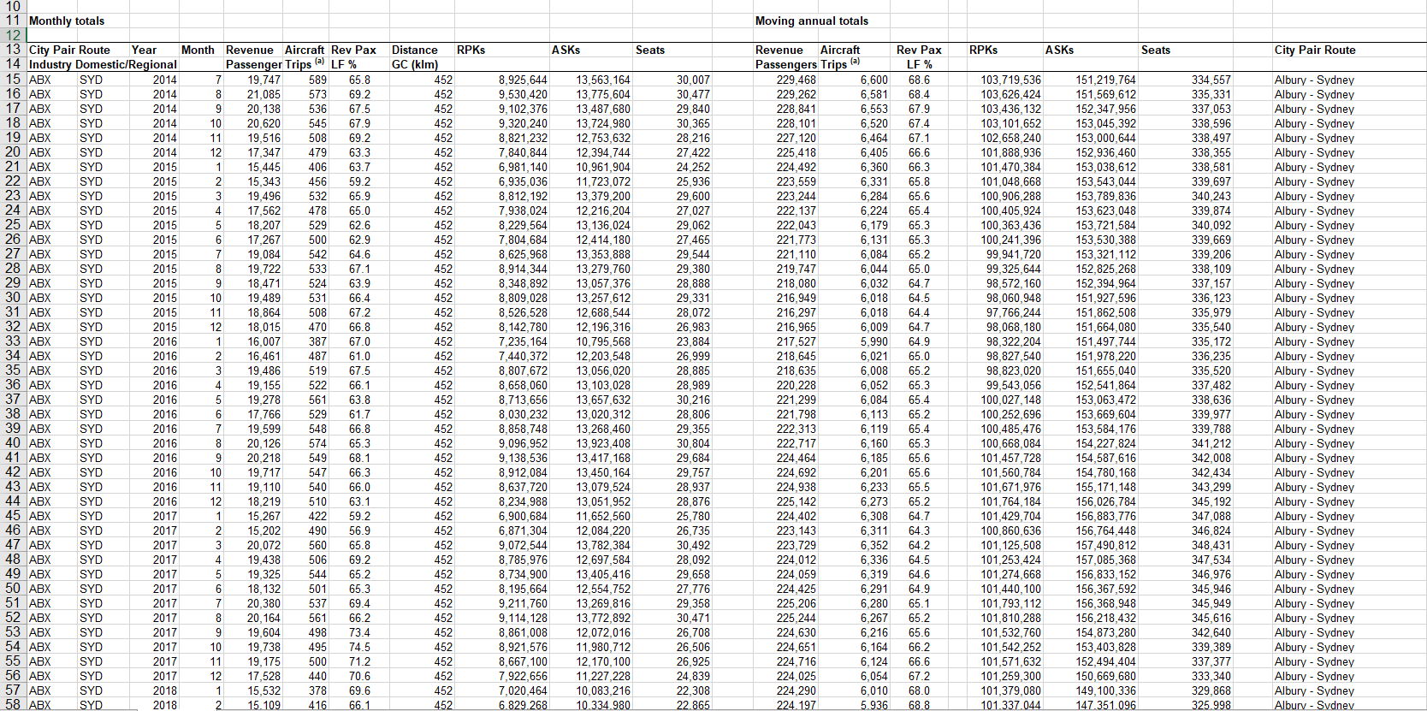

Slide 9
Processing

Slide 10

pandas used to combine excel spreadsheets into a data frame
Remove unnecessary columns while importing

Slide 11

xarray provides fantastic n-dimensional arrays
Pandas data is then converted to an xarray structure – simplifying working with multidimensional data

Slide 12
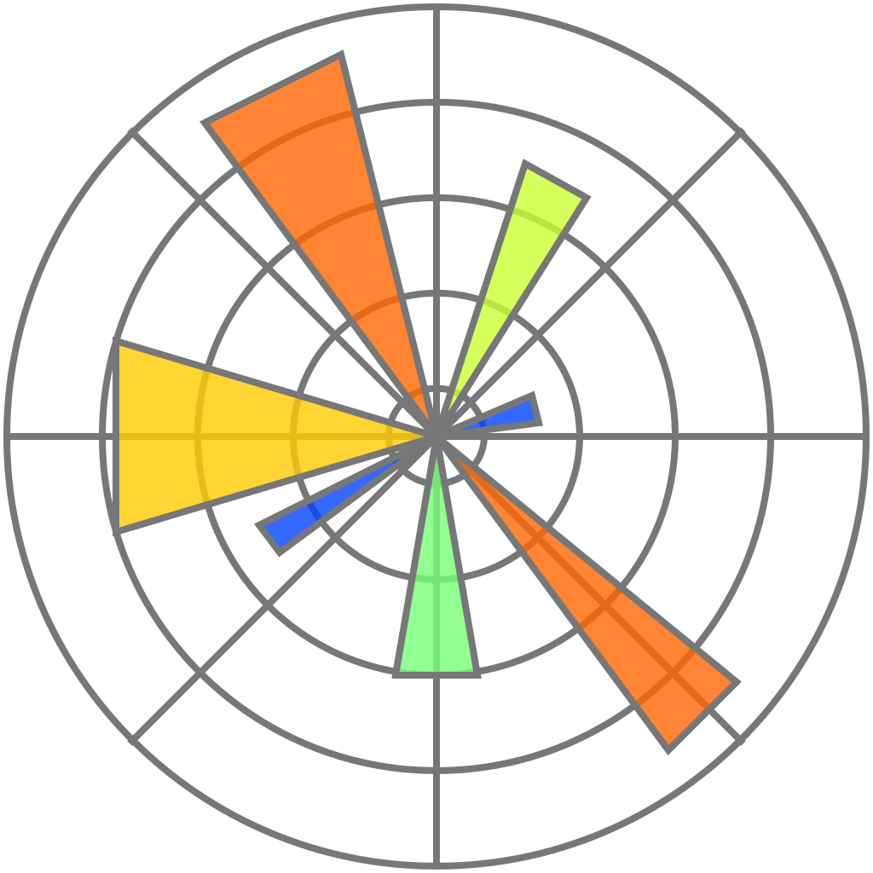
Visualisations are done using matplotlib

Slide 13
International Visualizations

Slide 14
International Visualizations
Important part for initial visualizations is to see overall Australian trends at a glance
To understand individual airports, it’s important to understand Australia as a whole

Slide 15
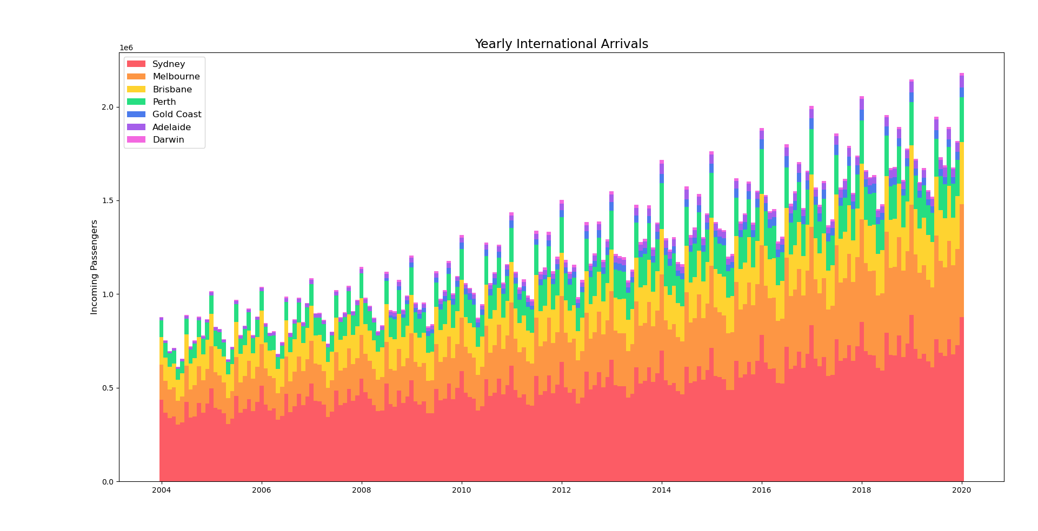
Monthly Arrivals
Stacked bar chart showing total arrivals in Australia each month
Arrivals are trending upward as times goes on
Volume oscillates on a seasonal basis

Slide 17
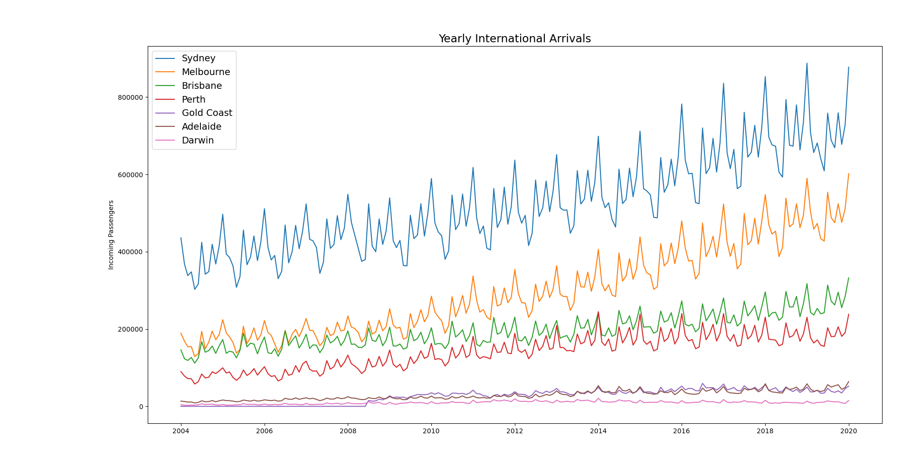
Monthly Arrivals
Can also be represented as a standard line chart
Easier to compare differences between airports

Slide 19
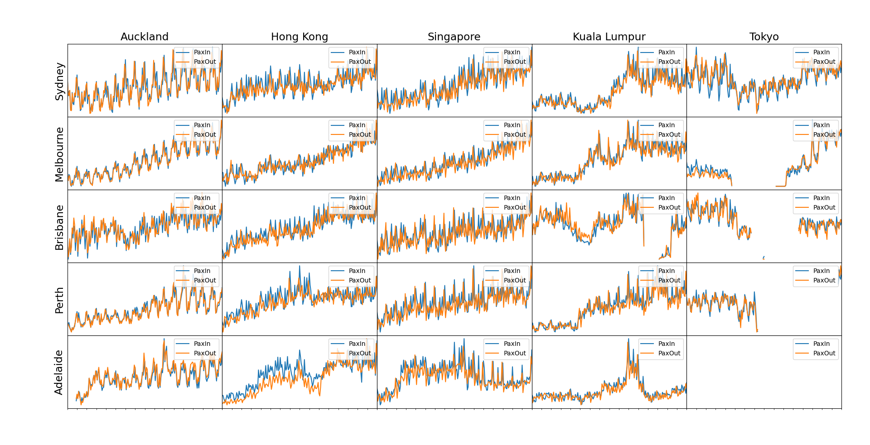
Trends
Trend graphs between various locations in Australia and international hotspots
Axes between charts are not to scale – trends only!
Similar upwards trend is visible
Seasonal fluctuations are more pronounced

Slide 21
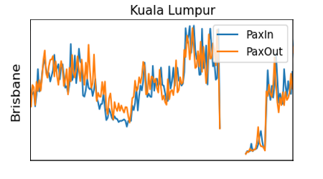
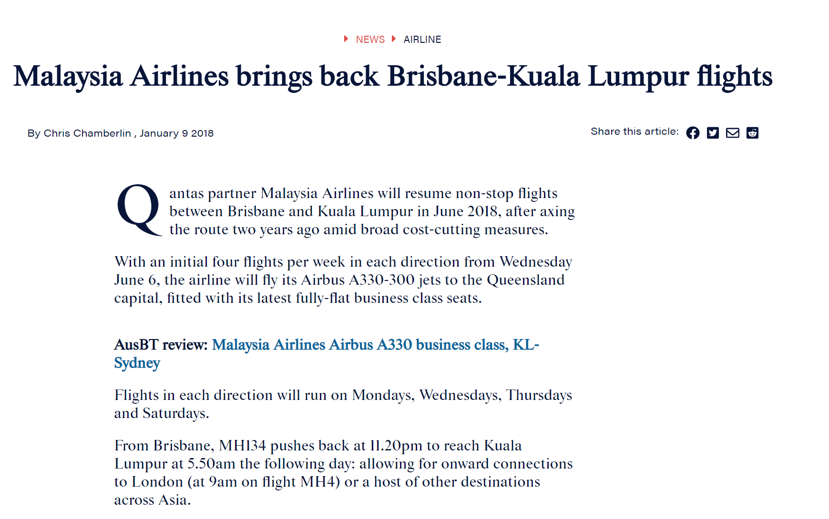
Trends
Certain events can have major impacts in the data

Slide 22
Trends
Is there a better way to view the seasonal trends?

Slide 23
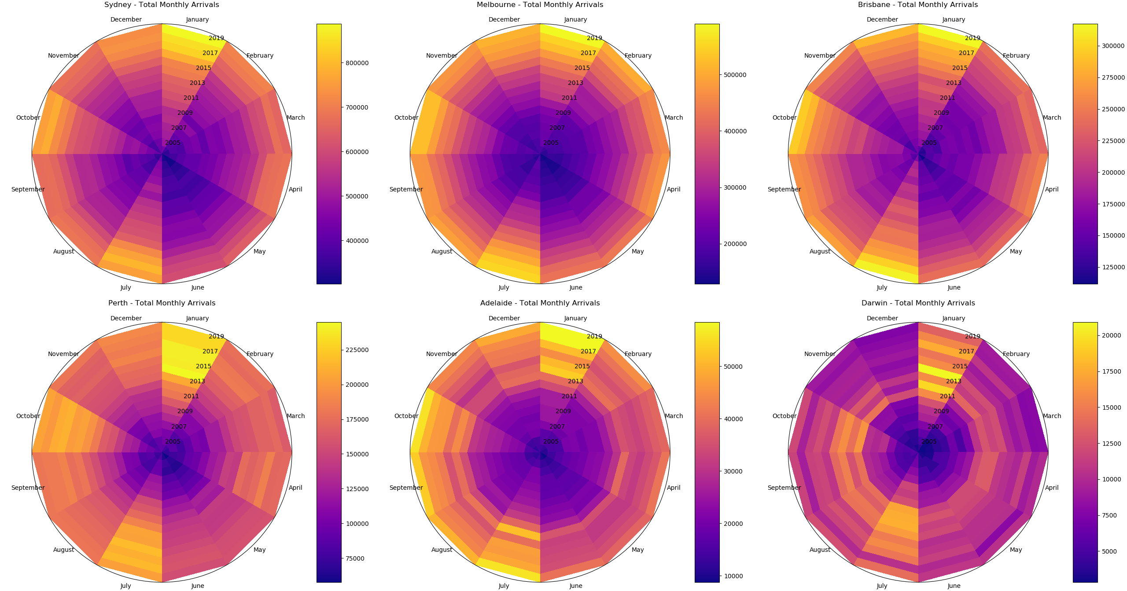
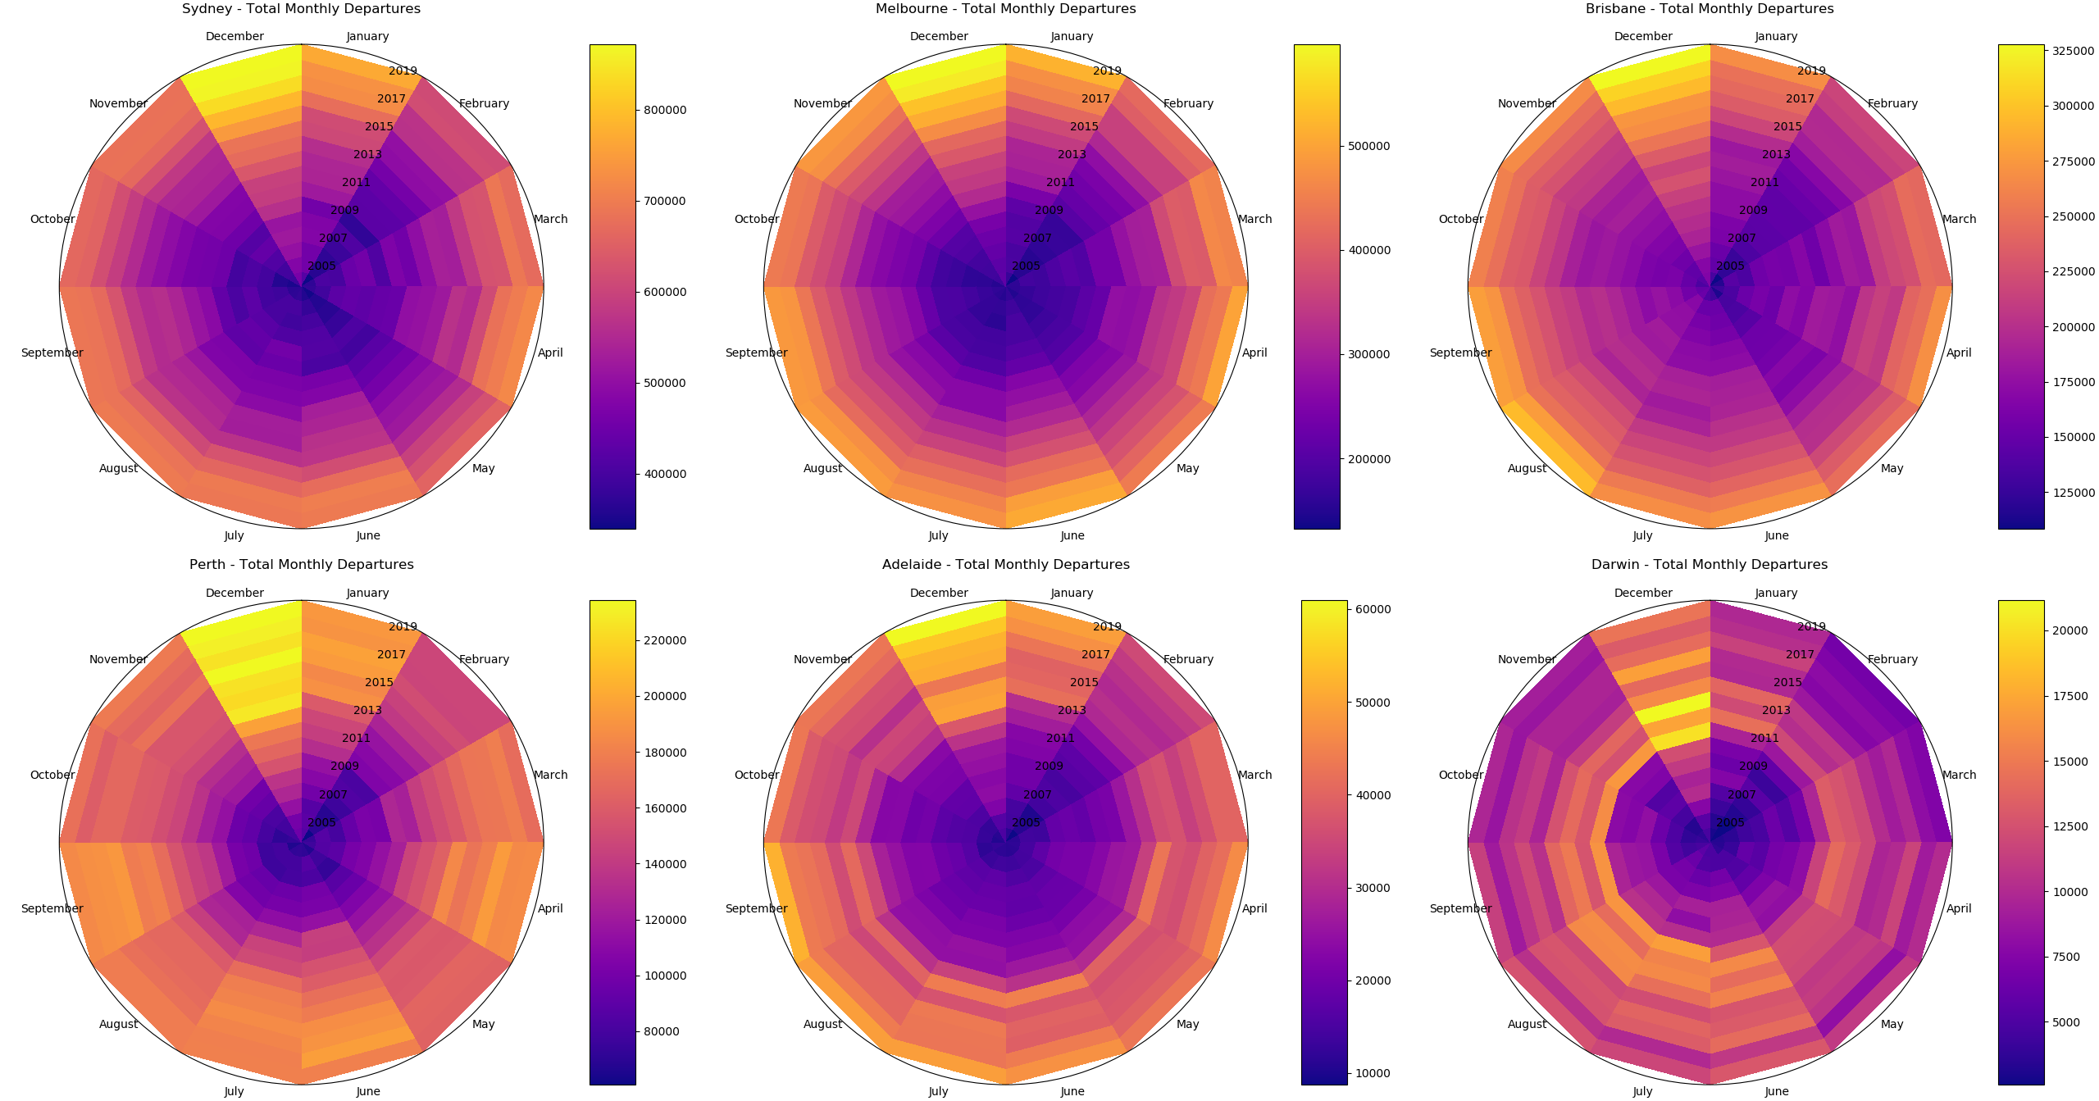
Trends
Good breakdown of month and year performance
Seasonal peaks are now more obvious

Slide 26
Domestic Visualizations

Slide 27
Domestic Visualizations
Domestic data is provided as city pairs (no directional information)

Slide 28
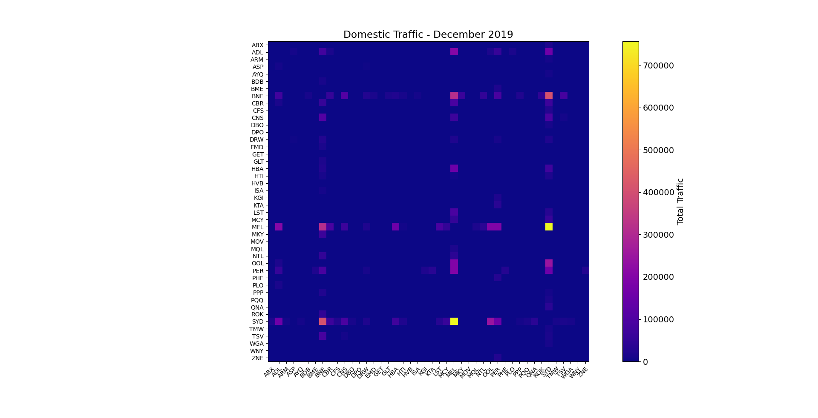
Heatmap
Heatmap showing connections between Australian airports
Primarily consists of regional airports connected to metropolitan airports

Slide 30
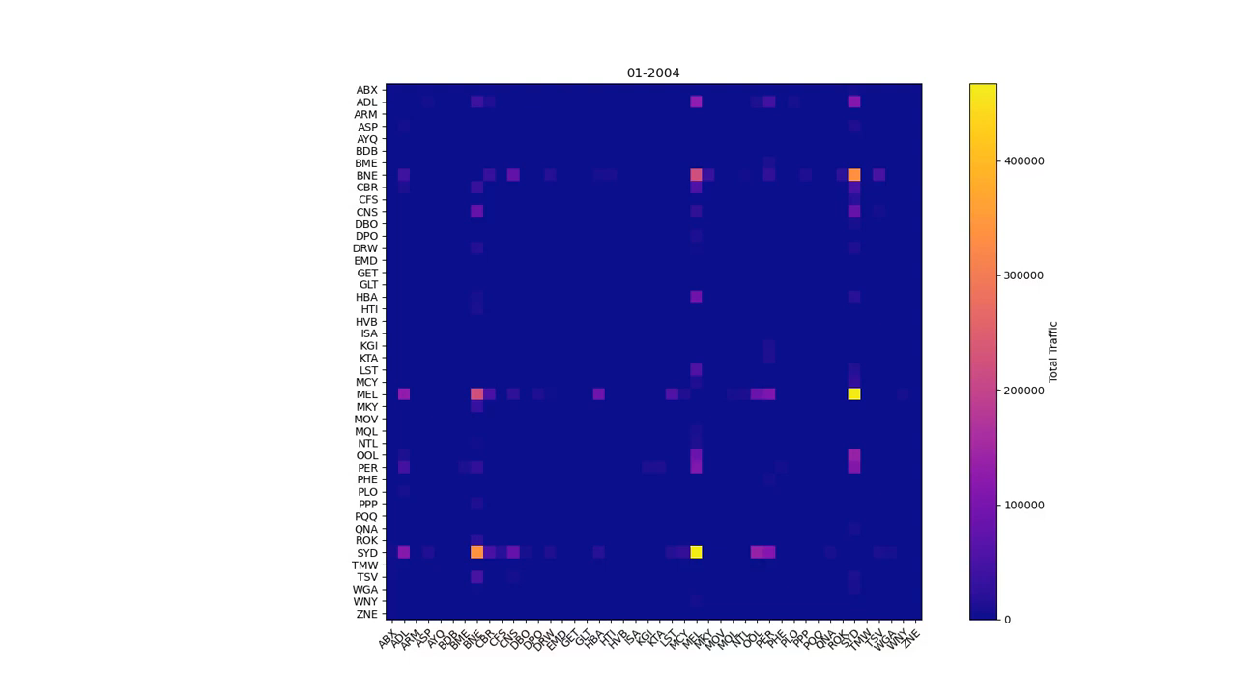

Slide 31
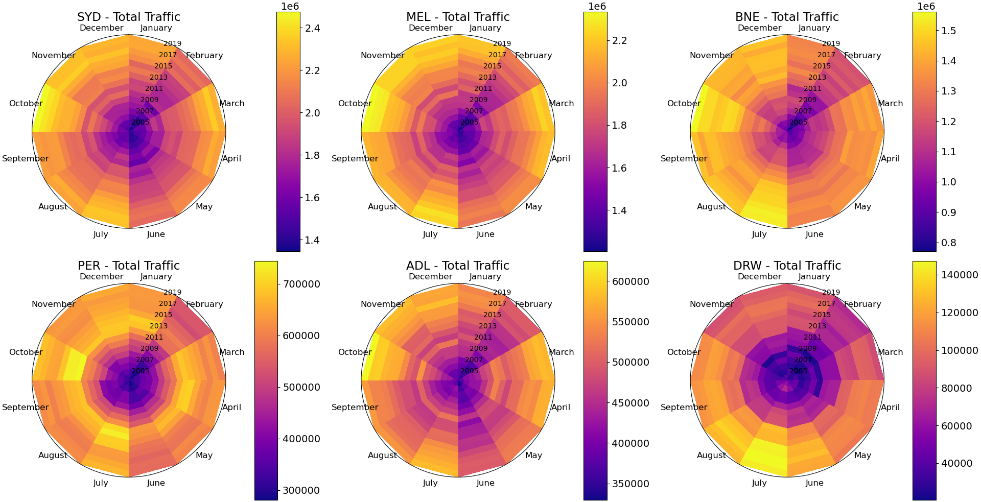
Trends
Less seasonal impact visible for domestic flights

Slide 33
Summary
Overall, Australian air traffic increases year by year
All air travel is affected by seasonal trends, peaking approximately every three months

Slide 34
Summary
International travel is more strongly affected by these seasonal trends
Regional airports in Australia are generally only connected to one or two “hub” airports
Larger airports are experiencing faster growth

